Slide 1
Nourriture - Connect People with Ingredients
fastDev@MongoDB+Mongoose
Beijing Jiao Tong University

Slide 2
The battle
RDBMS vs. Document Data Model
Beijing Jiao Tong University

Slide 3
Challenge to RDBMS
New Table
New Column
New Table
Beijing Jiao Tong University

Slide 4

RDBMS
Mental model
Relational model
Beijing Jiao Tong University

Slide 5
Document Data Model
Mental model
Document model
Beijing Jiao Tong University

Slide 6
Overview of mongoDB
Beijing Jiao Tong University

Slide 7
NoSQL vs. SQL
Non relational database vs. Relational database
key-value, graph, or document vs. RDBMS (table based)
Redis
Data is represented as a collection of key-value pairs, such that each possible key appears at most once in the collection
Neo4J
Elements interconnected with an undetermined number of relations between them
MongoDB
Documents encapsulate and encode data, and documents in a collection may have fields that are completely different
NoSQL is also named as ‘Not only SQL’
Beijing Jiao Tong University

Slide 8
Key Differences Compared to RDBMS
Pre-defined Schema
Structured Query Language
ACID (Vertical)
Atomicity: requires that each transaction be "all or nothing"
Consistency: ensures that any transaction will bring the database from one valid state to another
Isolation: ensures that the concurrent execution of transactions result in a system state that would be obtained if transactions were executed serially
Durability: ensure once a transaction has been committed, the data will remain so, even in the event of power loss
Dynamic Schema
Natural Query Language
CAP (Horizontal)
Consistency: all nodes see the same data at the same time
Availability : a guarantee that every request receives a response about whether it was successful or failed
Partition tolerance: the system continues to operate despite arbitrary message loss or failure of part of the system
Beijing Jiao Tong University

Slide 9
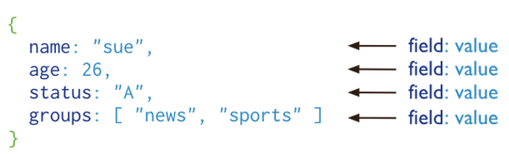
Basic Concept in MongoDB
Document
A record in MongoDB is a document (row), which is a data structure composed of field (column) and value pairs, and saved in collection (table).
BSON (Natural and Expressive)
MongoDB documents are similar to JSON objects.
Nest (Nested Array or Nested Document)
The values of fields may include other documents, arrays, and arrays of documents.
Beijing Jiao Tong University

Slide 10
Database Schema
It is the structure of database system described in a formal language supported by the DBMS
It refers to the organization of data as a blueprint of how a database is constructed (divided into database tables in the case of Relational Databases)
The schema defines the tables, fields, relationships, views, indexes, packages, procedures, functions, queues, triggers, types, sequences, materialized views, synonyms, database links, directories, XML schemas, and other elements.
Beijing Jiao Tong University

Slide 11
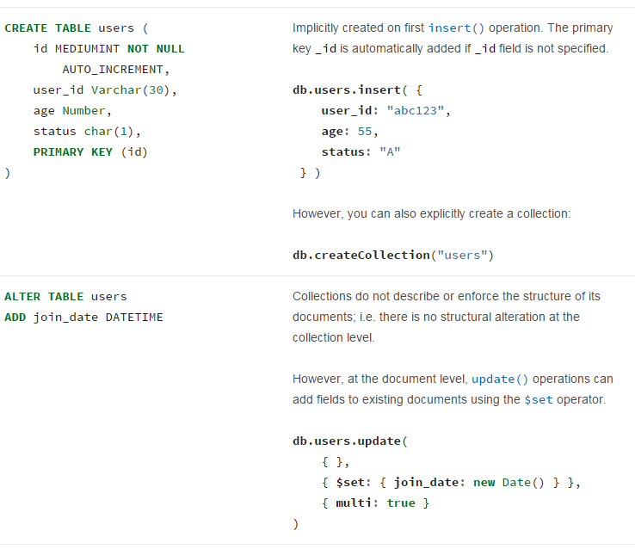
Comparison on Database Schema
Beijing Jiao Tong University

Slide 12
Query Language
Query languages are computer languages used to make queries into databases and information systems.
They can be classified into database query languages or information retrieval query languages that attempts to find documents containing information that is relevant to an area of inquiry (Natural and Expressive)
Beijing Jiao Tong University

Slide 13
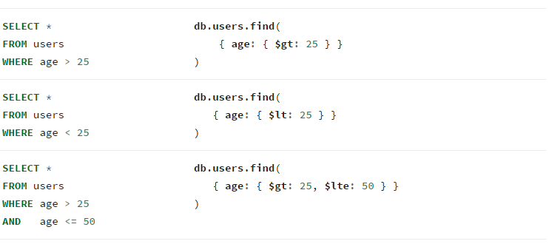
Comparison on Query Language
In the context of Operator usage ( > vs. $gt )
Beijing Jiao Tong University

Slide 14
Does MongoDB support ACID transactions?
Atomicity (Diff.)
It doesn’t support multiple documentations transaction, but it embed related data in nested arrays or nested documents within a single document and update the entire document in a single atomic operation.
Consistency (Diff.)
It doesn’t support multiple documentations transaction, instead it supports all nodes see the same data at the same time by Replica sets
Isolation (Same)
It doesn’t support to read uncommitted because each modification in document is isolated and clients never see documents in intermediate states
Durability (Same)
When mongod returns a successful journaled write concern, the data is fully committed to disk and will be available after mongod restarts, otherwise NOT
Beijing Jiao Tong University

Slide 15
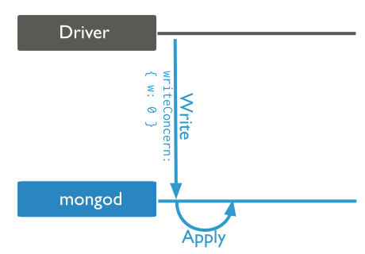
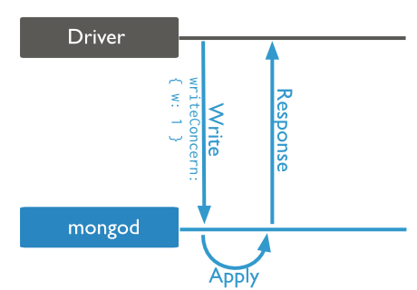
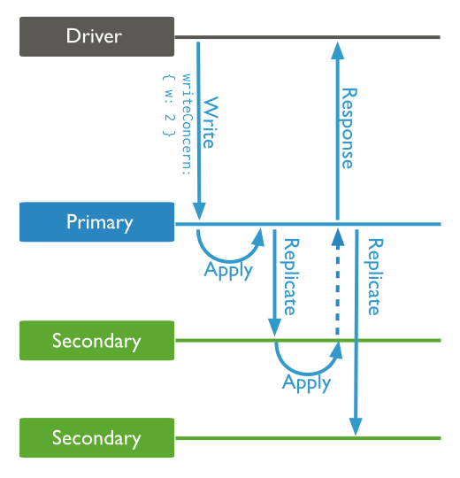
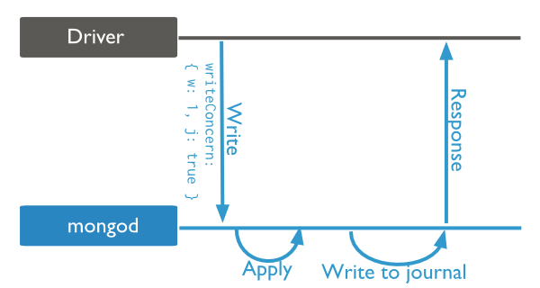
Write Concern
It describes the guarantee that MongoDB provides when reporting on the success of a write operation.
Unacknowledged
acknowledged
Journaled
Replica acknowledged
Beijing Jiao Tong University

Slide 16
Journaling Mechanics
On-disk Journal
When running with journaling, MongoDB stores and applies write operations in memory and in the on-disk journal before the changes are present in the data files on disk.
Journal Subdirectory
A journal subdirectory within the directory defined by dbPath, which is /data/db by default. A dirty shutdown (crash) leaves files in the journal directory
Journal Files
The journal files contain write-ahead redo logs that are append-only files and have file names prefixed with j._
Beijing Jiao Tong University

Slide 17
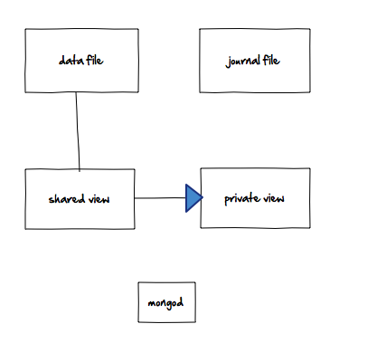
How Journaling @ memory map
load data to memory
mmap
Beijing Jiao Tong University

Slide 18
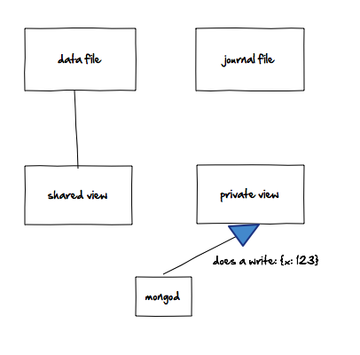
How Journaling @ does a write
Beijing Jiao Tong University

Slide 19
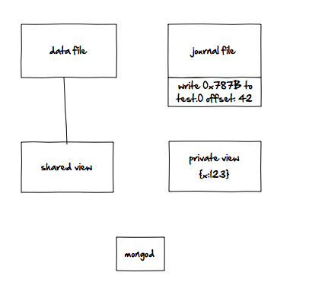
How Journaling @ after a write
write-ahead redo logs
Beijing Jiao Tong University

Slide 20
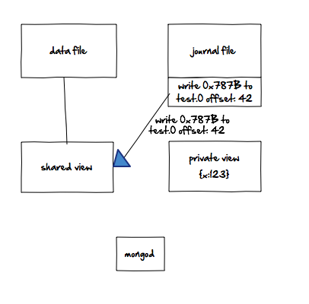
How Journaling @ when mongod crashes
Replay this change on the shared view
Beijing Jiao Tong University

Slide 21
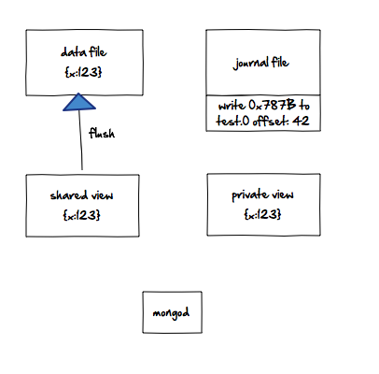
How Journaling @ flush the changes
The shared view will be flushed to disk in every 60 seconds
Beijing Jiao Tong University

Slide 22
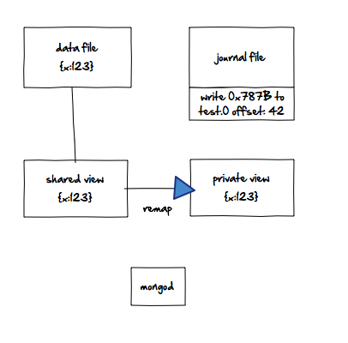
How Journaling @ memory remap
It prevents the private view from getting too “dirty” (having too many changes from the shared view it was mapped from).
Beijing Jiao Tong University

Slide 23
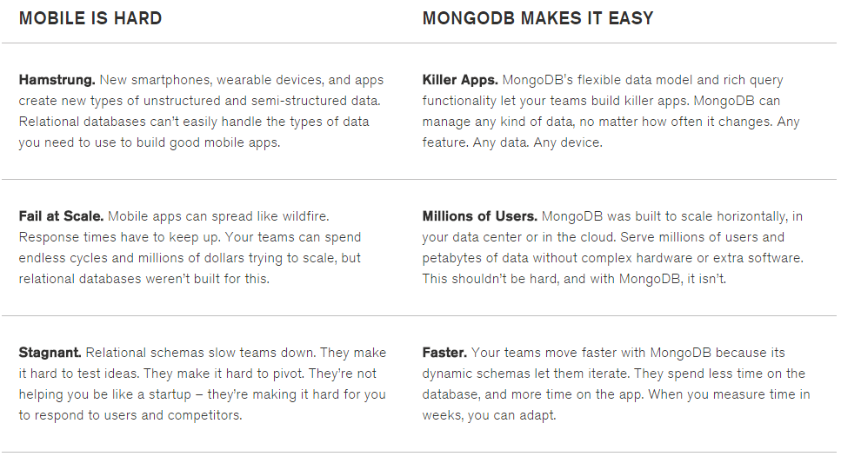
Understand “fall under which umbrella”
Fast ≈ The primary ‘gene’ of Mobile and Startup
Data migration due to structure change (Document)
Afford more users’ request by Sharding and Replica sets
Dynamic schema but NOT pre-defined
Beijing Jiao Tong University
Notes:
MongoDB provides horizontal scale-out for databases on low cost, commodity hardware using a technique called sharding, which is transparent to applications.
Sharding distributes data across multiple physical partitions called shards.
Sharding allows MongoDB deployments to address the hardware limitations of a single server, such as bottlenecks in RAM or disk I/O, without adding complexity to the application.
MongoDB automatically balances the data in the cluster as the data grows or the size of the cluster increases or decreases.

Slide 24
Mongo Wrong Use Cases
Developer productivity is not a concern for you
Limited vertical scalability is a comfort blanket
“It’s always been done this way”
See the future and know all possibilities for the schema
Beijing Jiao Tong University

Slide 25
Basis of mongoDB
Data Modeling and CRUD
Beijing Jiao Tong University

Slide 26
Data Modeling in MongoDB
The key challenge in data modeling is balancing
the needs of the application,
the performance characteristics of the database engine,
and the data retrieval patterns.
To represent the relationships of two documents by
embedded documents and references
Beijing Jiao Tong University

Slide 27
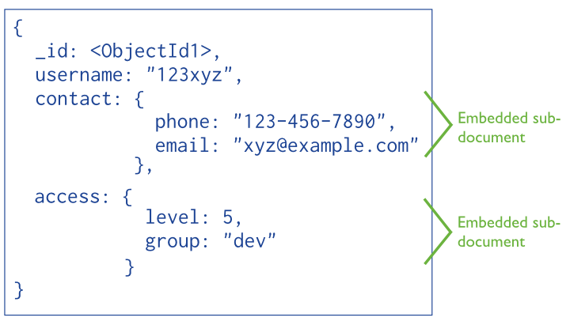
Denormalized Data Models (Embedded Docs )
It allows applications to store related pieces of information in the same database record
Scope:
--Can be applied for one-to-one and one-to-many ( The “many” or child documents always appear with or are viewed in the context of the “one” or parent documents)
Pros:
--Better performance due to less I/O (single database operation)
Cons:
--Document growth can impact write performance and lead to data fragmentation
Beijing Jiao Tong University

Slide 28
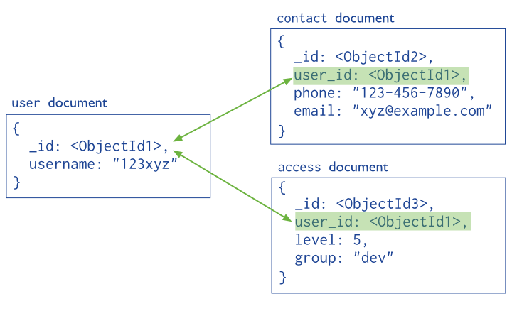
Normalized Data Models (References)
It describe relationships using references between documents
Scope:
--Can be applied for complex many-to-many and one-to-many (Avoid duplications)
Pros:
-- Provides more flexibility than embedding (large hierarchical data sets)
Cons:
--Must issue follow-up queries to resolve the references
Beijing Jiao Tong University

Slide 29
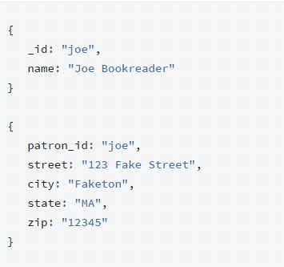
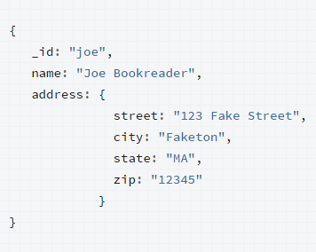
One-to-One Relationship
When app requests ‘address’, it have to issue multiple queries to resolve the reference
Single database operation is good enough to help us retrieve ‘address’
Beijing Jiao Tong University

Slide 30
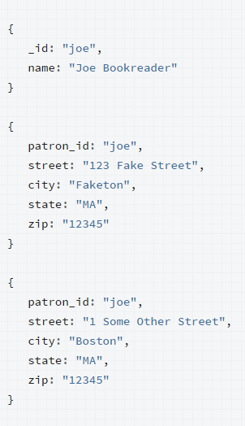
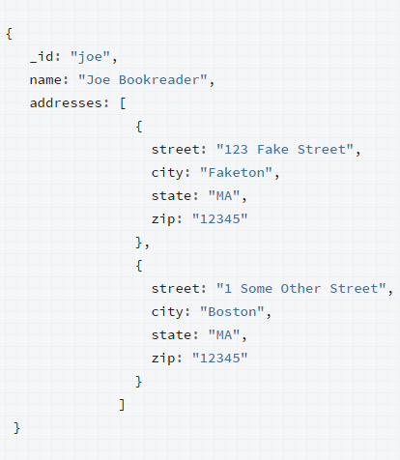
One-to-Many Relationship with Embedded Docs
When app requests ‘address’, it have to issue multiple queries to resolve the reference
Application can retrieve the complete patron information with one query
Beijing Jiao Tong University

Slide 31
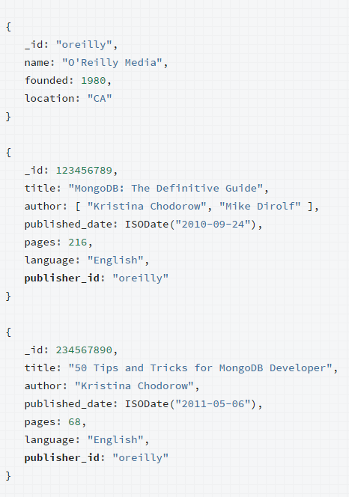
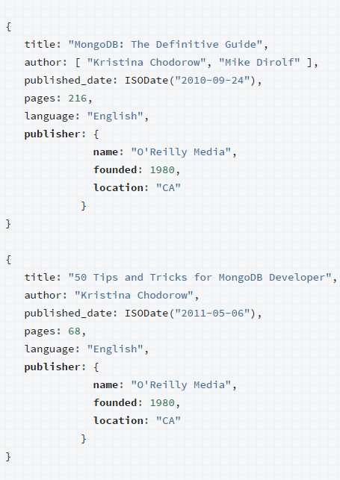
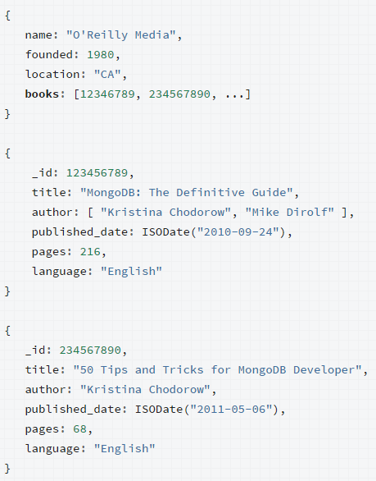
One-to-Many Relationship with References
Avoid mutable, growing arrays, store the publisher reference inside the book document
The number of books per publisher is unbounded
repetition of the publisher data
Beijing Jiao Tong University

Slide 32
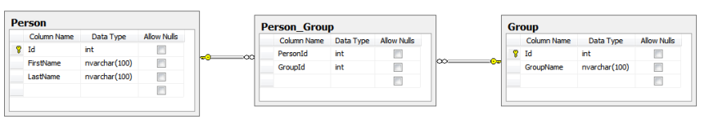
What Many-to-Many Relationship
That sounds relational. You might want to use a relational DB…
Beijing Jiao Tong University

Slide 33
Many-to-Many Relationship in MongoDB
MongoDB does not support joins, because denormalized data could be embedded in the document
The many-to-many relationship could be carried out by References
Beijing Jiao Tong University

Slide 34
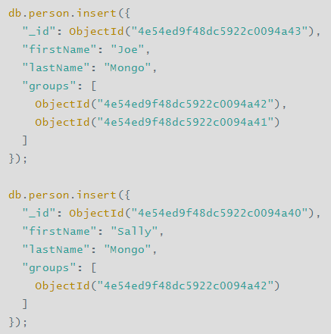
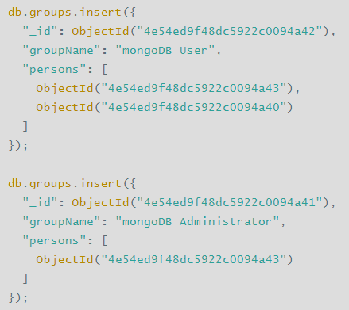
Many-to-Many by Manual References
Beijing Jiao Tong University

Slide 35
Operational Factors and Data Models
Document Growth
Avoid expected documentation growth by limitation
Atomicity
Ensure app stores all fields with atomic dependency requirements in the same document
Sharding
Provide horizontal scaling that clusters support deployments with large data sets and high-throughput operations
Indexes
Collections with high read-to-write ratio often benefit from additional indexes. Indexes do not affect un-indexed read operations, because indexes are expensive (insert must update any indexes). MongoDB automatically creates a unique index on the _id field
Large Number of Collections
If the total number of documents is low, you may group documents into collection by type, such as logs in different types
Data Lifecycle Management
Consider using the TTL (Time to Live) feature expires documents after a period of time, such as machine generated event data, logs, session information, etc
Beijing Jiao Tong University
Notes:
Trade-off between single atomic operation and issuing multi I/O

Slide 36
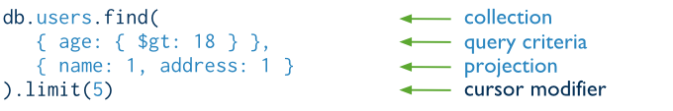
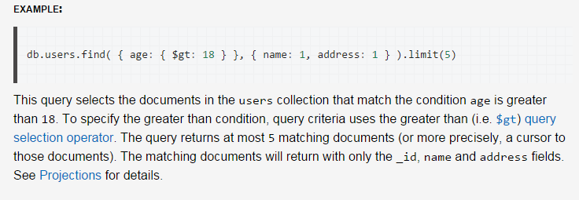
CRUD @ READ Operation
READ
Beijing Jiao Tong University

Slide 37
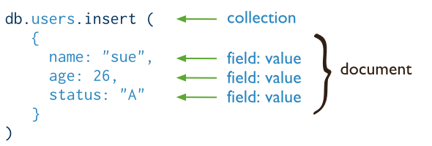
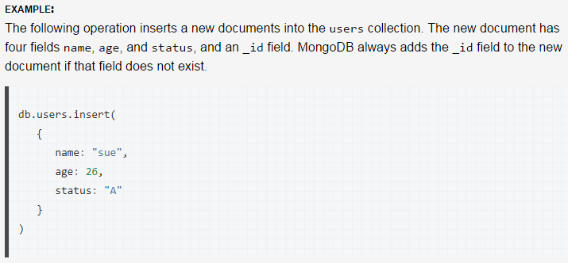
CRUD @ WRITE Operation
CREATE
Beijing Jiao Tong University

Slide 38
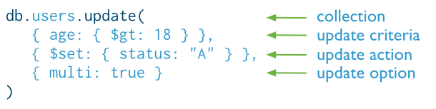
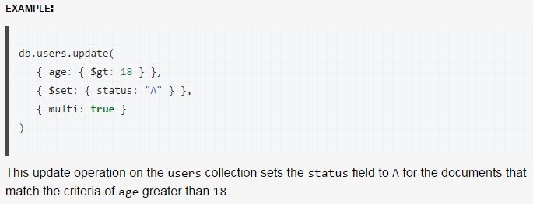
CRUD @ WRITE Operation
UPDATE
Beijing Jiao Tong University

Slide 39
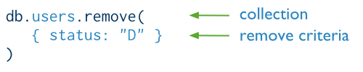
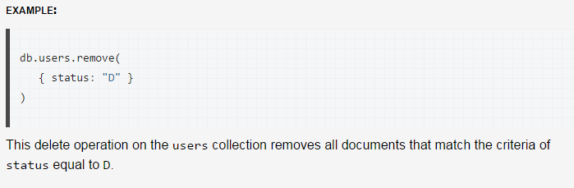
CRUD @ WRITE Operation
DELETE
Beijing Jiao Tong University

Slide 40
Driver of mongoDB
Mongoose
Beijing Jiao Tong University

Slide 41
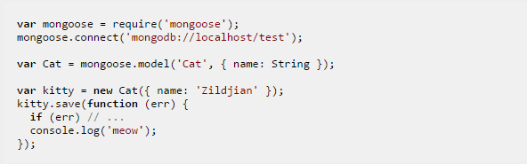
What Mongoose
It is the officially supported ODM for Node.js.
It has a thriving open source community and includes advanced schema-based features such as async validation, casting, object life-cycle management, pseudo-joins, and rich query builder support.
npm install mongoose
Create a collection with one field named as ‘name’
New an document and add it to the collection
Beijing Jiao Tong University

Slide 42
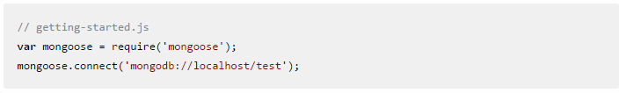
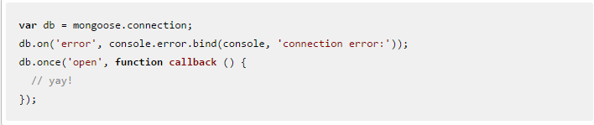
Get Started with Mongoose @DB connection
In this example, all following sources are managed in this callback
Beijing Jiao Tong University

Slide 43
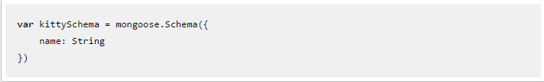
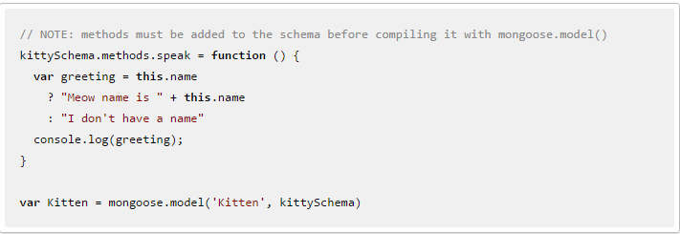
Get Started with Mongoose @Schema and Model
Define a Schema
Compile schema to model ‘Kitten’
Beijing Jiao Tong University

Slide 44
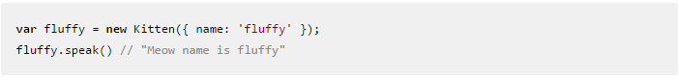
Get Started with Mongoose @New a Document
A document ‘fluffy’ who can speak
Beijing Jiao Tong University

Slide 45
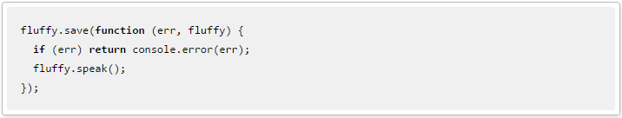
Get Started with Mongoose @Create a Document
CRUD @ CREATE
Beijing Jiao Tong University

Slide 46
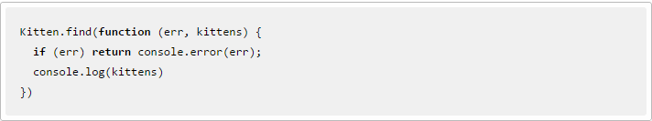
Get Started with Mongoose @Read a Document
CRUD @ READ
Beijing Jiao Tong University

Slide 47
Get Started with Mongoose @Read a Document by criteria
Search for all documents with a name property that begins with "Fluff"
Beijing Jiao Tong University

Slide 48
Reference
http://en.wikipedia.org/wiki/Database_schema
http://www.thegeekstuff.com/2014/01/sql-vs-nosql-db/
http://en.wikipedia.org/wiki/CAP_theorem
http://en.wikipedia.org/wiki/ACID
http://docs.mongodb.org/manual/core/write-concern/
http://docs.mongodb.org/manual/core/journaling/
http://blog.mongodb.org/post/33700094220/how-mongodbs-journaling-works
http://www.mongodb.com/mongodb-architecture
https://www.mongodb.com/use-cases/mobile
http://docs.mongodb.org/manual/reference/sql-comparison/
http://stackoverflow.com/questions/2336700/mongodb-many-to-many-association
http://blog.markstarkman.com/blog/2011/09/15/mongodb-many-to-many-relationship-data-modeling/
http://mongoosejs.com/docs/index.html
Beijing Jiao Tong University

